Slide 1
Integrated Public Alert and Warning System
May 3, 2018

Slide 2
Agenda
IPAWS Program
System Overview
Current Usage
Future Plans
Questions

Slide 3
The Evolution of Emergency Alerting
Notes:
Past, Present, Future
Note that subscription-based alerting should be in there circa 2000 and beyond

Slide 4
IPAWS Federal Guidance
Policy:
Executive Order 13407 - Public Alert and Warning System
Establishes policy of the United States to have an national warning system used by government officials at all levels of government to alert and warn people of all hazards
Law:
Public Law 114-143, The IPAWS Modernization Act
Enacts to law the policy statement and similar requirements found in Executive Order 13407
Section 706 of 47 U.S.C. 606, The War Powers Act
Provides for Presidential access to commercial communications during “a state of public peril or disaster or other national emergency”
Public Law 93-288, The Stafford Act
Sec. 202. Disaster warnings – directs FEMA to provide technical assistance to State and local governments to insure that timely and effective disaster warning is provided
Regulation:
47 CFR Part 11 — Emergency Alert System (EAS)
Provides for alert and warning on private sector radio and television infrastructure
47 CFR PART 10 — Wireless Emergency Alerts (WEA)
Provides for alert and warning to devices on wireless carrier networks

Slide 5
IPAWS Modernization Act of 2015
Signed by POTUS April 11, 2016
(Public Law 114 -143)
Amends Title V of the Homeland Security Act of 2002, adding new Sec.526
Modernize IPAWS to ensure the President can communicate under all conditions
Allow Federal, State, tribal, and local (FSTL) governments access at other times
Establishes a new IPAWS Subcommittee in the National Advisory Council
40 members (8 Designated Senior Federal Officials)
Membership approved by FEMA Administrator
Directs Annual Report be submitted to two Senate Committees and two House Committees
Senate: Homeland Security & Gov’t Affairs and Commerce, Science & Transportation
House: Homeland Security and Transportation & Infrastructure
Integrates IPAWS Training into NIMS

Slide 6
What is IPAWS?
A national program to ensure that under all conditions the President can alert and warn the civilian population in areas endangered by natural disasters, acts of terrorism, and other man-made disasters or threats to public safety – EO 13407 June 2006, PL 114-143 April 2016
provides authenticated emergency alert and warning messaging from emergency officials to the public through:
radio and television via the Emergency Alert System
cellular phones via Wireless Emergency Alerts
NOAA All Hazards Weather Radio via IPAWS-NOAA gateway
Internet applications and websites via the IPAWS Alerts Feed
Future technologies…
Capabilities extended to Federal, State, local, territorial and Tribal governments

Slide 7
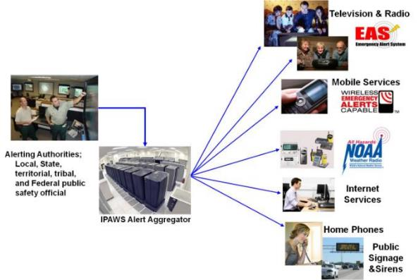
The IPAWS Vision
One alert to several public dissemination channels
Incorporated into mass notification systems - easier to use by public safety/alerting authorities
Improves and enhances alert and warning capabilities:
Increases alert coverage
Increases likelihood public will take action
Increases awareness
“Timely Alert And Warning To American Citizens In The Preservation of Life And Property”

Slide 8
IPAWS - Two Systems
-Over 1000 Users-
NPWS
President
Users
FEMA Gateway
Private Sector
People
951 Local authorities
Emergency Alert System
26,000 radio, TV cable providers monitor the IPAWS EAS Feed
67 State authorities
IPAWS OPEN
Wireless Emergency Alerts
63 Cellular Carriers = WEA to millions of handsets
3 Territorial authorities
IPAWS-OPEN
3 Tribal Nations
NOAA
NOAA Weather Radio*
*NOAA Weather Radio connection inactive pending further development and testing
2 Federal authorities
Internet
73 Internet apps vendors have access to the All Hazards Alert & Info Feed
Canadian
MASAS
as of 17 Jan 2018

Slide 9
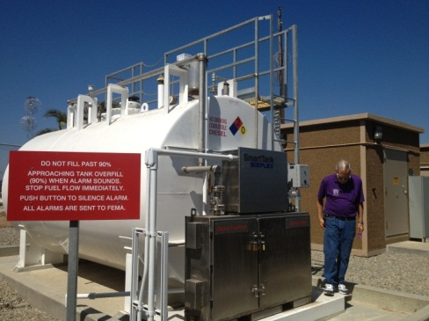
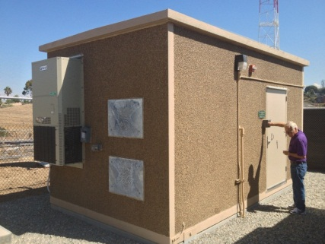
NPWS Primary Entry Point (PEP) Stations
Private Sector radio stations participating cooperatively with FEMA
FEMA provided, installed and maintained:
Power generator and extended fuel supply system
Communications equipment:
Telephone lines and audio coupler
“Special” EAS encoder/decoder
Satellite communications
Backup transmitter and broadcast equipment
Several configurations of PEP Station
Expansion stations – newly outfitted in last several years. Include modular “out” building, EMP protected generators and EMP protected back-up transmitters.
“Legacy” stations – original program stations dating from early 1990’s. No EMP or back-up transmitters. Various fuel system and generator configurations.
Other – non-improved and auxiliaries stations
IPAWS Program is retrofitting/modernizing remaining legacy PEP stations planned to complete in FY24.

Slide 10
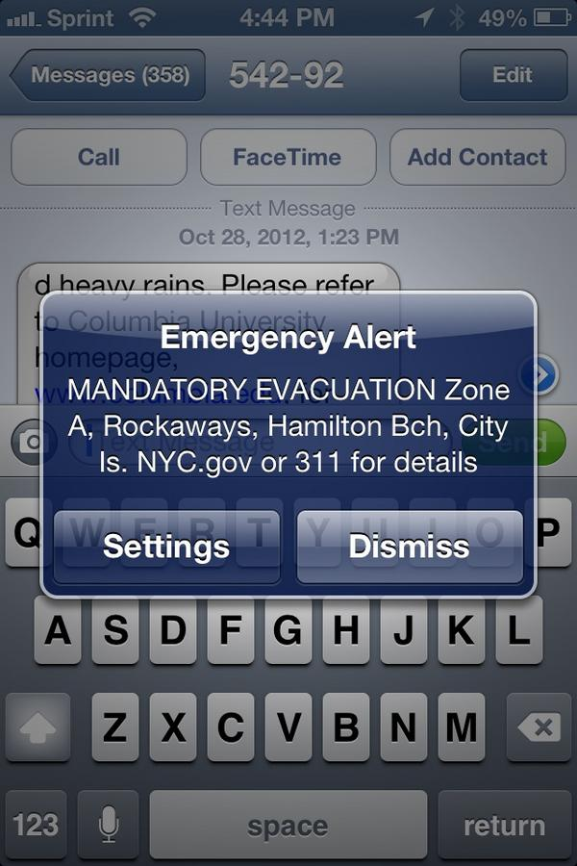
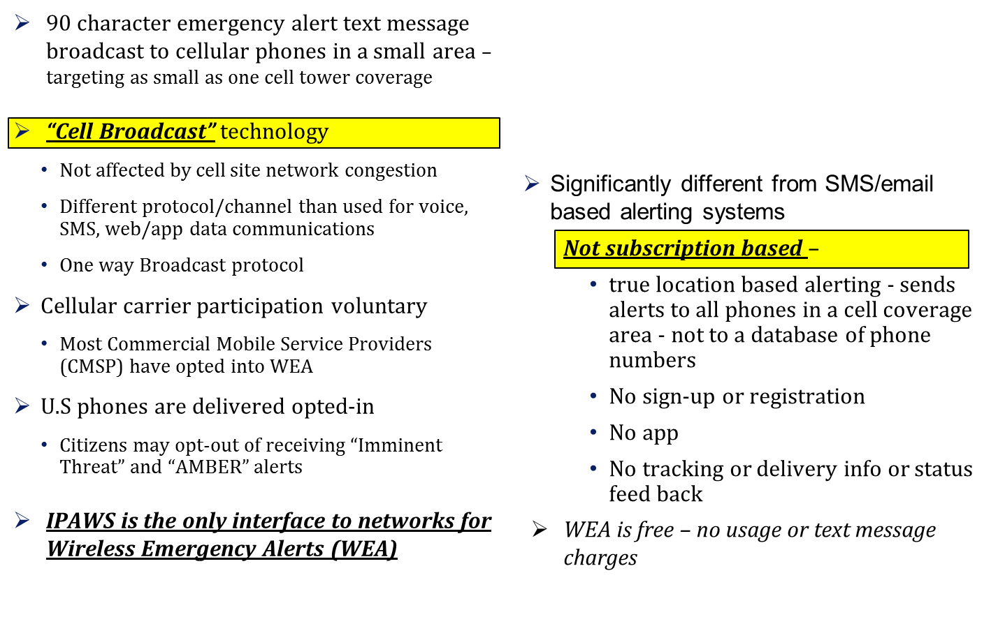
Wireless Emergency Alert Capabilities
10

Slide 11
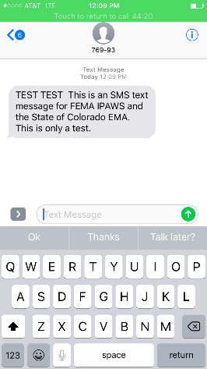
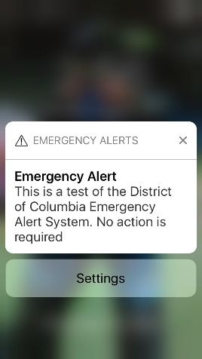
SMS vs. WEA
SMS is a text message
Opt-in
Service congestion
Not specific to handset location
Your text message alert noise
WEA is cellular broadcast
No need to opt-in
No message congestion
Specific to handset location
Unique tones, similar to EAS

Slide 12
WEA Improvements
Increase message length from 90 to 360 characters (May 2019)
Add new alert category, “Public Safety Messages” (May 2019)
Support URLs and phone numbers
Text URLs and phone numbers (Nov 2016)
“Clickable” URLs and phone numbers (Nov 2017)
Spanish language WEA (May 2019)
WEA test code (May 2019)
Deliver message to 100% of the target area with no more than 0.1 mile overshoot (Nov 2019)
Preserve alerts on phone for 24 hours (Nov 2019)
https://apps.fcc.gov/edocs_public/attachmatch/FCC-16-127A1.pdf
https://apps.fcc.gov/edocs_public/attachmatch/FCC-18-4A1.pdf

Slide 13
When is IPAWS Used?
When public safety officials need to warn of a threat to public safety:
Evacuation
Shelter-In-Place
Law Enforcement Situations
911 Outage
Road Closure
Chemical Spill/Release
Water Contamination
Distribution Location
Emergency Relief Location
Emergency Shelter Locations
Dam Release Alert
Child Abductions/AMBER Alerts
Critical Power Outage
Nuclear Accident
Landslide
Pipe Line Break
Extreme Weather
Flooding
Volcano
Earthquakes
Wildfires
Notes:
KEY POINTS:
All emergencies start local; authorities nationwide use IPAWS at their discretion to send local warning and emergency information to people in their jurisdictions
39,000 messages processed each month, load balanced between FEMA and DHS DC2 infrastructures
ADDITIONAL INFO:
The creativity of local authorities in using IPAWS to send local emergency warnings to cell phones is impressive and reinforces that all emergencies are local
The National Center for Missing and Exploited Children began using IPAWS in 2012 supporting State AMBER Coordinators to spread word of missing endangered children that helps law enforcement to quickly recover missing children; recovery of 25 missing children has been directly attributed to people receiving an AMBER Alert WEA message on their cell phone
The National Weather Service has been the largest IPAWS user; NWS uses IPAWS to send six types of severe weather warnings to cell phones via WEA, but also posts all weather warnings, watches, advisories, statements, and updates to the IPAWS All Hazards Information Feed; testimonials and stories of people saved by a NWS tornado or severe weather warning received as a WEA on a cell phone continue to add up
NWS weather warning types sent via WEA are: - tornado - flash flooding - extreme wind
- dust storm - tsunami - hurricane

Slide 14
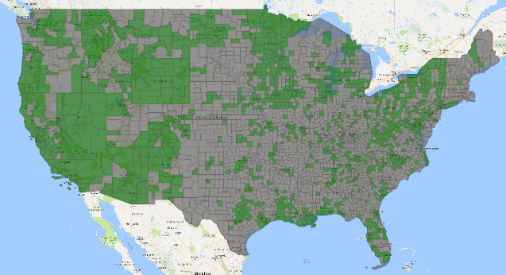
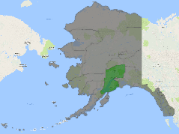
Current Alerting Authorities (as of April 19, 2018)
1,045 Total IPAWS Public Alerting Authorities:
970* Local (*includes 15 military bases)
67 State-wide
3 Territory
3 Tribal
2 National
Counties in Green have at least one local authority with IPAWS Public Alerting Access
More than 66.7% of the population are covered by a local alerting authority

Slide 15
Usage Statistics (as of April 17, 2018)
2,835,468
Total messages processed by IPAWS
36,938
Total Wireless Emergency Alert (WEA) messages sent
34,788
WEAs sent by NWS
1,192
WEAs sent by NCMEC
958
WEAs sent by state/local
11,200
Total Emergency Alert System (EAS) messages sent
10,276
EAS, including tests, sent by state/local
926
EAS non-test sent by state/local

Slide 16
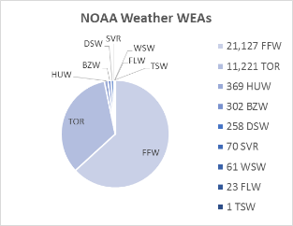
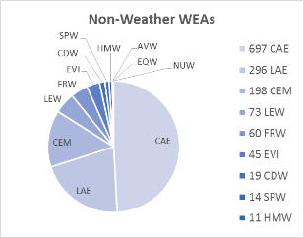
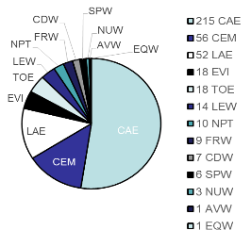
WEA Usage Statistics (as of Jan 17, 2018)
*
*Chart does not include over 32,000 alerts sent by NWS or over 1,000 AMBER Alerts sent by NCMEC since 2012
Non-Weather WEAs
EAS Activations
NOAA Weather WEAs

Slide 17
National Blue Alert - DOJ Partnership Blue Alert National Network
What is a Blue Alert?
Blue Alerts are warnings, issued primarily by states, for rapid dissemination of information to law enforcement agencies, the media, and the public to aid in the apprehension of violent offenders who have killed, or seriously injured an officer in the in the line of duty. Blue Alerts can also be issued when a suspect poses an imminent and credible threat to law enforcement or when an officer is missing in the line of duty.
Named for two fallen New York City Police Department (NYPD) officers who were horrifically ambushed in December 2014, the Rafael Ramos and Wenjian Liu National Blue Alert Act was enacted to establish a nationwide Blue Alert communications network.
Press event announcing rollout of Blue Alert National Network
May 19, 2017
DOJ AG Press Room
IPAWS serves as system for rapid dissemination of Blue Alerts

Slide 18
Emerging Technologies Limited Engagement
AWARN
SIRIUS/XM
HSIN PILOT
Multi-lingual alerts (ECHO Minnesota)
Ubiquitous Alerting

Slide 19
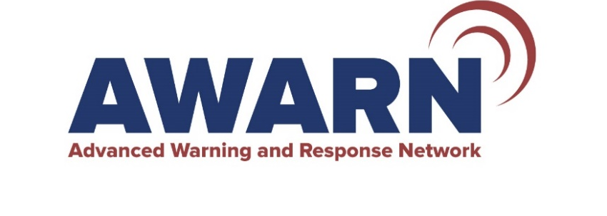
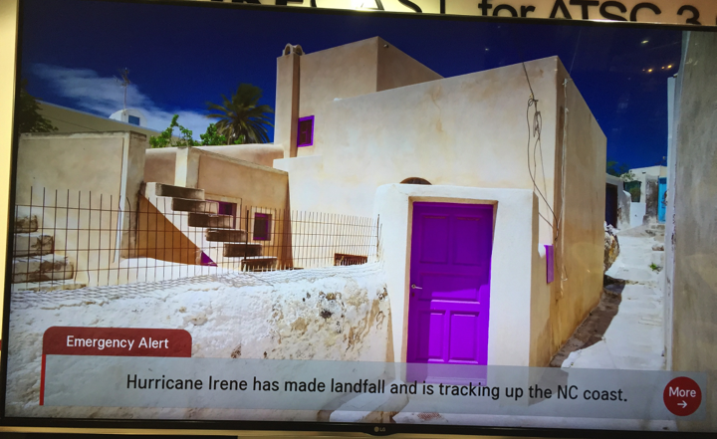
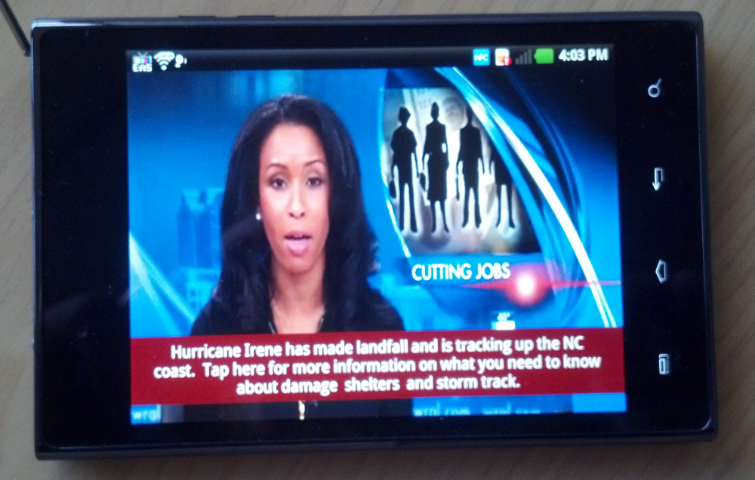
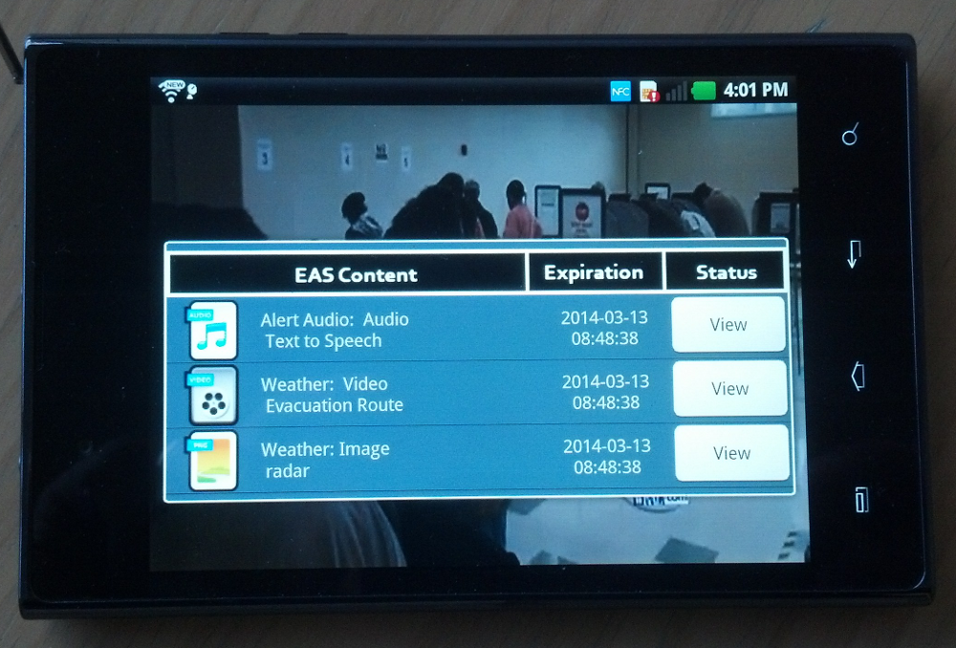
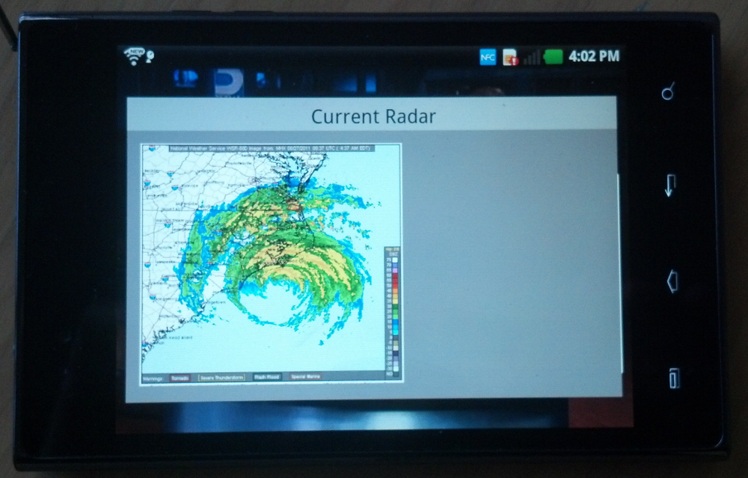
Next generation for delivery of emergency information to the public.
Based on next-generation television broadcasting standard – ATSC 3.0
Alerts simultaneously sent to TV sets, tablets, in-car systems, and smartphones etc. without using cellular data.
Delivers rich media content even if the cell network fails and the electric grid is down – indoors or outside
Pipeline for acute warnings and extensive information for disaster preparation and response.
CAP and IPAWS compliant.
Banner Alert on In-Home TV
Pop-up Alert Message
Associated Media Menu
Selected Rich Media
www.awarn.org

Slide 20
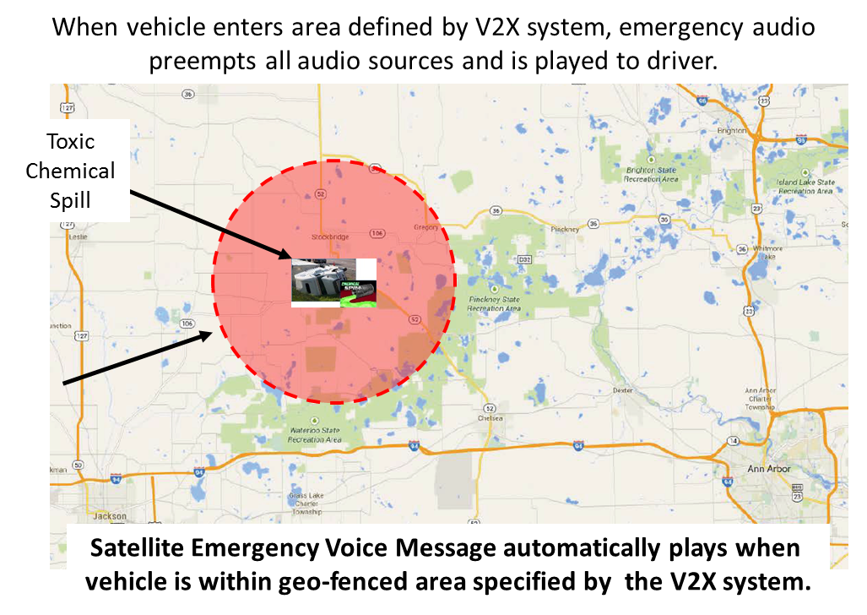
SIRIUS XM
Satellite fleet covers contiguous US and elsewhere in North America
Terrestrial repeater network supplements service in urban areas where satellite reception could be blocked by buildings or other obstacles
Satellite receivers are factory installed in ~ 70% of all new vehicles sold in the US
IPAWS OPEN
Satellite Based Delivery

Slide 21
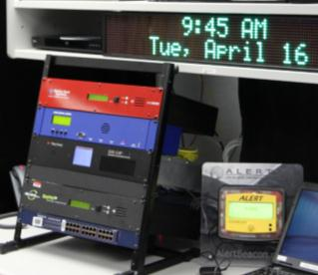
IPAWS Lab
IPAWS Test Lab supports alert and warning system evaluation, demonstration, exercises, testing, and proactive
Offline version of IPAWS with closed network alert broadcast systems
Alert viewer website –practice sending alerts and see system results

Slide 22
ipaws@fema.dhs.gov

Slide 23
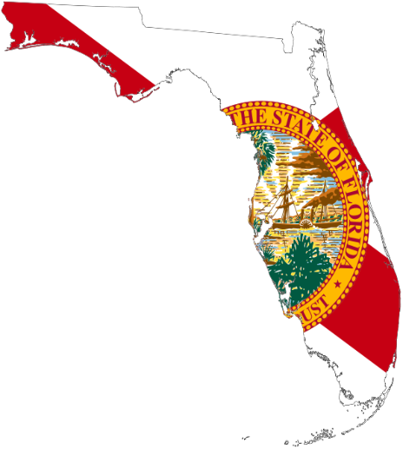
WEAs Sent during Hurricanes HARVEY/IRMA/MARIA
IRMA: State and local alerting authorities issued a series of timely WEA and EAS alerts to advise the public to take appropriate protective measures. The Florida Division of Emergency Management (FDEM) issued several evacuation alerts which enabled nearly 6.5 million residents to safely evacuate. FDEM issued IPAWS alerts on the behalf of counties that were unable to issue an alert because they are not an authorized alerting authority (Hendry County), demonstrating in this instance state-local coordination.
MARIA: FEMA IPAWS developed an innovative arrangement with SirusXM to deploy satellite radios to Puerto Rico. Extensive efforts by the IPAWS PMO successfully kept PEP stations broadcasting in Puerto Rico to provide critical response and recovery information to the island’s residents. Efforts included coordinating fueling where power was unavailable, and providing technical assistance where needed and feasible. NCP CCD had the human resources capability, financial resources, and the tools to respond. CCD leadership was fully engaged at the outset. In USVI, FEMA IPAWS had primed the backup generator two years ago and had recently replaced the fuel tank generator and fuel distribution systems in June 2017.
Citrus County Mandatory Evacuation ordered. Check media outlets.
-FL Citrus County Sheriff's Office Emergency Management
EXTREME HIGH STORM SURGE ANTICIPATED FOR WEST CITRUS COUNTY, EVACUATE NOW, DON'T WAIT. -FL Citrus County Sheriff's Office Emergency Management
Emergency Alert in this area until 2:11 AM EDT Evacuate Now EMnet-FL.00
-FL Florida Division of Emergency Management
Strong winds are beginning to occur across Pinellas County. Take Shelter Immediately!
-FL Pinellas County
DICKINSON is under a MANDATORY EVACUATION. We may not be able to rescue anyone who stays
– TX Galveston County Office of Emergency Management
Creeks are in flood stage. If you are in a low lying area, move to higher ground.
-TX Montgomery County Office of Emergency Management
Call 911 for LIFE THREATENING emergencies ONLY. STAY PUT IF SAFE. Monitor media
- TX Harris County
FOR FEMA ASSISTANCE CALL 1-800-621-FEMA (3362) OR www.fema.gov/apply-assistance
– TX Galveston County Office of Emergency Management

Slide 24
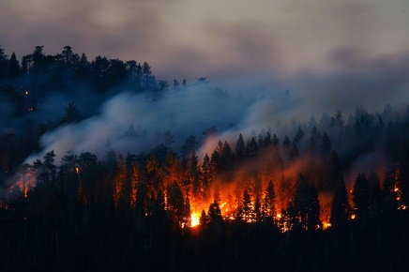
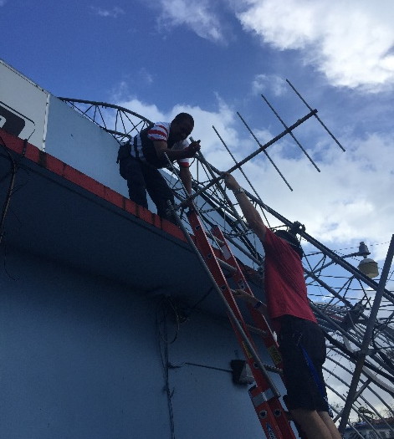
National Public Warning System A Lifeline For Information
Our IPAWS Team and contractors provided emergency sustainment to the IPAWS National Public Warning System (NPWS) broadcast stations in the US Virgin Islands and Puerto Rico in the immediate aftermath of Hurricanes Irma and Maria. The NPWS stations, WSTA in St. Thomas and WKAQ in San Juan were the only broadcast stations on the air during landfall of these storms and continue to provide life-saving information to over 3.5 million residents in the islands. We also facilitated the provision and distribution of over 10,000 portable radios with spare batteries for distribution to the public.

Slide 25
WEAs Sent During California Wild Fires
Four WEAs were issued to warn California residents about wildfire danger. Not one of the confirmed California fire-related deaths occurred in Lake County. Fatalities were recorded in counties that did not issue a WEA suggesting the warning may have contributed to saving lives. Lake County did have a smaller area impacted by the fire compared to neighboring counties.
Residents in four counties impacted by the wildfires did not receive a WEA. These include counties that are authorized IPAWS alerting authorities: Sonoma County Fire and Emergency Services Department, and Mendocino County Sheriff's Office. Yuba and Napa counties are not alerting authorities, but the CA OEM could have issued alerts for their areas (if their digital cert was operational) but did not do so.
Strong public appetite to receive timely and actionable wildfire alerts was demonstrated by the large number who signed up for the subscription based messages. For example, Napa County with a population of 140,000 reported an increase in subscribers to their Nixle service from 20,000 before the fires to 135,000 in the aftermath.
The IPAWS PMO encourages states to establish coordination policies with local jurisdictions to ensure alerts can be sent on their behalf if they are not an alerting authority or are unable to issue alerts and warning.
Mandatory Evacuations for Orange Park Acres, North Tustin, East Orange. Monitor media.
-CA Orange County
Mandatory evacuations for Sulpher Fire. Elem Colony &amp; N. Clearlake Shelter @ Twin Pines.
- CA Lake County Sheriff's Office of Emergency Services
Evacuation center open at 10 Avenue of the Flags, San Rafael for Napa/Sonoma fire evacuees
- CA Marin County Sheriff's Office of Emergency Services
Evacuation UPDATE! Shelter in Place or go to the Community Center on Wolf Creek Road.
-CA Lake County Sheriff's Office of Emergency Services

Slide 26
WILDFIRE EVACUATIONS IN SAN LUIS OBISPO COUNTY, CA
IPAWS Use Case
Wildfires swept across over 40,000 acres in San Luis Obispo County, destroying 48 homes.
Emergency officials sent three WEAs to people in specific areas of the fire advising them to evacuate.
One emergency official said the WEAs had produced “excellent results,” noting that a WEA sent at 7:50pm Sunday evening was received by a local citizen and re-posted to social media shortly after.
Officials coordinated WEA messages with neighboring Monterey County to manage evacuations
August 2016)
Photo courtesy of calfireslo.org
“Evacuation ORDER for OakShores, X-Cove, CalShasta, RanchoDeLago & SoShoreVillage. EVAC NOW”
“EVAC ORDER:BeeRock,x-MasCove& OakShores GoEASTonG14 past NaciDam. FailureMayPrevEscape L8r”
“Tule Road residents only, evacuate now due to a brush fire moving toward Tule road.”

Slide 27
GUNMAN STANDOFF
IPAWS Use Case
"We used some new technology through hyper-reach, and notified people via landline phones and blasted out a messages to cell phones in the area that we did have a person in the area with a high powered rifle and to stay in their residence and to lock their residence and to call if they have any problems," said Livingston County Undersheriff Matthew Bean.
When two roommates argued and one of them threatened the other with a high powered rifle, police set up a perimeter and evacuated nearby homes.
http://www.twcnews.com/nys/rochester/news/2015/05/7/mount-morris-standoff.html
May 7, 2015
“The Livingston County Sheriff's Office is currently working an investigation on Dutch Stre”
“Sheriff Dougherty requesting people stay inside til further notice. Emergency on Dutch St”

Slide 28
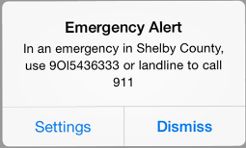
911 OUTAGES FOR WIRELESS CUSTOMERS
IPAWS Use Case
Due to an event that affected the delivery of wireless calls to 911, Public Safety Answering Points (PSAPs) in West Tennessee. Tennessee Emergency Management Agency (TEMA) issued a WEA for each particular county affected in West Tennessee
Shelby County
Crockett County
Dyer County
Hardeman County
McNair County
Weakly County
http://www.wmcactionnews5.com/story/26535381/911-trouble-continues-new-backup-numbers-released
September 15, 2014

Slide 29
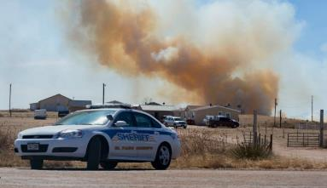
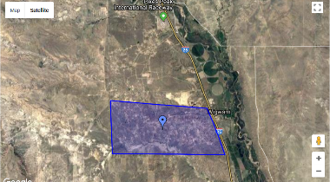
FIRE EVACUATIONS IN EL PASO COUNTY, CO
IPAWS Use Case
El Paso County emergency officials provided an update on its Facebook page, saying 250 homes are under evacuation orders in El Paso County. The Pueblo County Sheriff's Office said 69 homes are under those orders in Pueblo County.
http://www.koaa.com/story/37742915/at-least-2000-acres-multiple-structures-burn-in-carson-midway-fire
https://www.denverpost.com/2018/03/18/carson-midway-fire-sunday-update/
March 16, 2018
“Fire near Indian Village Hts - Evac Mandatory - Evac Route Indian Village East to I25.”

Slide 30
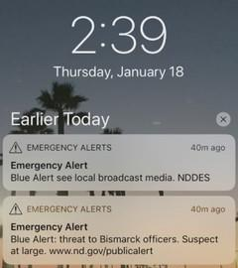
BLUE ALERT, BISMARK, ND
IPAWS Use Case
Sgt. Mark Buschena says police were assisting parole or probation agents checking on an individual about 11 a.m. Thursday when a man fleeing from the scene in vehicle attempted to hit the officer. Buschena says the officer fired at the vehicle, but was not struck.
http://www.valleynewslive.com/content/news/Bismarck-police-seek-suspect-who-tried-to-run-over-an-officer-469963323.html
http://www.myndnow.com/news/minot-news/how-does-an-emergency-system-work/926773397
January 18, 2018

